Slide 1

Members of the public can address the Board on items on the agenda at the time the item is being addressed or during Public Comments for topics that are not listed on the agenda.
Speakers are limited to three (3) minutes each. Please submit a Speaker’s Slip to the Board Clerk prior to the announcement of the item to be heard. In conformance with the Brown Act, no Board action can occur on items presented during Public Comment.

Slide 2
Board of Directors Meeting
September 24, 2026

Slide 3
Members of the public can address the Board on items on the agenda at the time the item is being addressed or during Public Comments for topics that are not listed on the agenda.
Speakers are limited to three (3) minutes each. Please submit a Speaker’s Slip to the Board Clerk prior to the announcement of the item to be heard. In conformance with the Brown Act, no Board action can occur on items presented during Public Comment.

Slide 4
Item 9: Clean Energy Alliance Chief Executive Officer Operational and Administrative Report

Slide 5
CEA Enrollment Statistics
Item 9
Member City | Eligible Accounts | Clean Impact 50% Renewable | Clean Impact Plus 55% Renewable/ 75% Carbon Free | Green Impact 100% Renewable | Participation Rate
Carlsbad | 55455 | 269 | 49491 | 656 | 91%
Del Mar | 3029 | 12 | 2755 | 73 | 94%
Escondido | 57412 | 258 | 53434 | 70 | 94%
Oceanside | 75015 | 355 | 69408 | 105 | 93%
San Marcos | 38226 | 205 | 34978 | 457 | 93%
Solana Beach | 8048 | 28 | 7188 | 170 | 92%
Vista | 39621 | 175 | 36876 | 352 | 94%
TOTAL | 276806 | 1302 | 254130 | 1883 | 93%
CEA serves a total of 257,315 customer accounts across its seven member agencies
Metrics as of September 1, 2026.

Slide 6
Completed Community Events
Item 9
Date | Description | City
July 31, 2026 | Chavez Community Center Food Distribution | Oceanside
August 1, 2026 | California Center for the Arts: Back 2 School | Escondido
August 4, 2026 | National Night Out | Oceanside
August 5, 2026 | City of Escondido City Council Meeting | Escondido
August 7, 2026 | Libby Lake Community Center Food Distribution | Oceanside
August 8, 2026 | Flapjacks for Backpacks | San Marcos
August 11, 2026 | City of Vista Council Presentation with Luminia | Vista
August 19, 2026 | Carlsbad Chamber of Commerce Board of Directors | Online

Slide 7
Completed Community Events
Item 9
Date | Description | City
August 20, 2026 | California Hispanic Chambers of Commerce's Procurement Matchmaking | Oakland
August 26, 2026 | Vista Environmental Commission Presentation | Vista
September 1, 2026 | MainStreet Oceanside | Oceanside
September 2, 2026 | Mature Adult Center Open House | Solana Beach
September 4, 2026 | Cal Cities Padres Game | San Diego
September 10, 2026 | Orange Glen High School Back to School Night | Escondido
September 17, 2026 | CPUC Voting Meeting | San Marcos
September 19, 2026 | NCAAWA Gentlemen's Gourmet | Oceanside
September 22, 2026 | VIP Donor Appreciation Evening for Moonlight Amphitheater | Vista

Slide 8
Upcoming Community Events
Item 9
Date | Description | City
September 26, 2026 | Cyclovia | Vista
September 30, 2026 | CPUC Small & Diverse Business Expo | San Francisco
September 30, 2026 | SD Farm Bureau - Farmer of the Year | Escondido
October 1, 2026 | CPUC - GO 156 Supplier Diversity En Banc | San Francisco
October 1, 2026 | Energy Academy | San Diego
October 2, 2026 | US Marine Corps Fall Carnival | Oceanside
October 2, 2026 | Oceanside Heroes Banquet | Oceanside
October 3, 2026 | CEA/Frontwave Day of Service | Carlsbad
October 7, 2026 | Del Mar Climate Symposium | Del Mar

Slide 9
Upcoming Community Events
Item 9
Date | Description | City
October 7, 2026 | Clean Air Day (SDCW) | San Diego
October 8, 2026 | Solana Beach School District Board Meeting | Solana Beach
October 11, 2026 | San Marcos Harvest Festival | San Marcos
October 17, 2026 | NAACP Freedom Fund Gala | Carlsbad
October 25, 2026 | APPA Customer Connections Conference | Nashville

Slide 10
Rate Relief Credit Opt-Downs
Item 9
Member City | Commercial | Residential | Total
Carlsbad | 4 | 102 | 106
Del Mar | 0 | 4 | 4
Escondido | 4 | 110 | 114
Oceanside | 7 | 158 | 165
San Marcos | 1 | 93 | 94
Solana Beach | 0 | 12 | 12
Vista | 3 | 94 | 97
TOTAL | 19 | 573 | 592
Percentage breakdown of customer opt-downs by method:
  61% via Call Center
    Of the call center opt-downs, 49% specifically mentioned Rate Relief Credit as the reason
  37% via self-service Web form
  2% through self-service Interactive Voice Response (IVR)
Metrics as of September 3, 2026.

Slide 11
Solar Plus and Battery Bonus Update
Item 9
Member City | Solar Plus |  | Solar Plus Connect |  | Battery Bonus |  | Battery Bonus Connect
Status | Active | Complete | Active | Complete | Active | Complete | Active | Complete
Carlsbad | 3 | 3 | 3 | 0 | 0 | 3 | 3 | 7
Del Mar | 0 | 0 | 1 | 0 | 0 | 0 | 1 | 0
Escondido | 10 | 5 | 13 | 0 | 0 | 0 | 3 | 9
Oceanside | 8 | 6 | 6 | 0 | 0 | 0 | 3 | 11
San Marcos | 3 | 4 | 3 | 0 | 1 | 1 | 2 | 6
Solana Beach | 0 | 1 | 1 | 0 | 0 | 0 | 1 | 1
Vista | 5 | 2 | 7 | 0 | 1 | 1 | 3 | 10
TOTAL | 29 | 21 | 34 | 0 | 2 | 5 | 16 | 44
MoM CHANGE | +11 | +1 | 0 | 0 | 0 | 0 | -2 | +2
Metrics as of Aug. 27, 2026.
MoM refers to Month-over-Month Change.

Slide 12
Connect Programs SGIP Funding
Item 9
Member City | Solar Plus Connect | Battery Bonus Connect
Carlsbad | $85,120 | $178,200
Del Mar | $26,032 | $0
Escondido | $398,748 | $237,600
Oceanside | $180,315 | $246,599
San Marcos | $89,877 | $158,400
Solana Beach | $25,426 | $39,600
Vista | $164,972 | $271,596
TOTAL | $970,490 | $1,131,996
Metrics as of Aug. 27, 2026.

Slide 13
PeakSmart Savers Participants
Item 9
Member City | PeakSmart Savers Participants
Carlsbad | 15
Del Mar | 1
Escondido | 19
Oceanside | 22
San Marcos | 3
Solana Beach | 0
Vista | 16
TOTAL | 76
MoM Change | +13
Metrics as of Aug. 31, 2026.
MoM = Month-over-Month

Slide 14
California Climate Credit Update
Item 9
In March 2026, CPUC Decision D.26-03-013 temporarily paused distribution of the Climate Credit
  Funded by CA Cap-and-Investment Program
Electric Climate Credit
  Historically applied in April/October
  CPUC directed credit be applied to high usage months
  Residential credit shifted to August/September in 2026
  Customers have now received the first of two $49.36 electric credits directly on their bill over the past two months
  Second payment due this month

Slide 15
Staff Event Highlights
Item 9
San Diego Energy & Climate Resilience Leadership Summit
  August 27, 2026 event hosted by the San Diego Regional Climate Collaborative
  Event provided an opportunity to learn from and connect with energy and climate resilience professionals in the San Diego County region.
California Hispanic Chamber of Commerce Convention (CHCC) – Procurement Matchmaking
  August 20, 2026, event held at the 47th Annual CHCC Statewide Convention in Oakland.
  Event provided an opportunity to connect with small businesses, women-owned businesses, and minority-owned businesses
  Event also provided an opportunity to inform on procurement opportunities that within the California Community Choice Aggregation and energy sector.

Slide 16
Recruitment Update
Item 9
Rates Specialist/Analyst
  Interviews Conducted on September 21, 2026
  Final Interviews on September 24, 2026
  Offer to selected candidate expected on September 25, 2026
Marketing Specialist/Analyst
  Interviews Conducted on September 22, 2026
  Final Interviews on October 6 & 7, 2026
Energy Data Analyst
  Job Posting/Recruitment to begin early October, 2026

Slide 17
Questions/Discussion – Item 9

Slide 18
Item 10: Consideration of Resolution Amending and Adopting a Bad Debt, Delinquent Account, and Collections Policy

Slide 19
Item 10
WHY THE UPDATE
What’s driving the change
Policy Review
New Policies
Discovered outdated policies that do not align with current CEA or other CCA practices.
Need for an unclaimed funds policy that does not exist and currently nothing is being done with unclaimed funds.
Need for Regular Clean Ups
Threshold Limits are Too Low
Establishing a regular monthly and/or annual process helps to keep clean-ups manageable and accounting up to date.
Realigning with industry practices compared to other CCAs and evaluation of impact of write-offs at old thresholds versus new thresholds.
19
Notes:
So what is causing us to make changes to these two policies?
We began reviewing the policies as we were discussing arrearages a few months back. Two things that were identified right away was that we needed to confirm the process for notifications to customers of past due charges and that our dollar thresholds for write-offs seemed low compared to other CCAs. This triggered us to review the full policy for edits and think about other policies we may need to establish such as an unclaimed funds policy.
In reviewing and writing the new steps, we determined we need to include in the policy and internally establish a regular scheduled clean up of funds that end up sitting in the unclaimed account and follow through with the processes in our policies to provide as much up-front due diligence to get customers their payments as we can.
As mentioned in the policy review step, our threshold limits for write offs, sending customers to collections, and taking legal action needed to be adjusted. We looked at what other CCAs were doing and did some analysis on the impact of changing the write-off amounts.

Slide 20
Item 10
Policy No. CEA-05
Collections Policy: What Changed
AREA
PREVIOUS
UPDATED
Format and title
Title box
Removed title box, updated fonts, style, headers, section titles and policy name
1.0 Purpose
Delinquent accounts, write off, and collections
Added late payment notification
2.0 Organizations affected
CEA
Updated to 2.0 Applicability and added Back Office Service provider, and Collections Agency
3.0 References and 4.0 Definitions
None
Removed References and added definitions table
4.0 Policy
Low dollar thresholds, no language for laws and regulations, or CEO authorization to cancel collections accounts
Updated pre-collection notification and removed $ threshold, reordered steps 3-4 and increased write-off threshold to $99.99 and $100 to refer to collections, legal action threshold increased to $5,000, added steps 5, 9 and 11.
Notes:
This is a quick run down of what we are proposing to change.
First the collections policy format was outdated and updated to remove the title box at the top and match the overall format, font, and style or current policies. We also updated the title of this policy to expand beyond just collections.
Section 1.0 for the purpose did not include late payment notification, so it has been added.
Section 2.0 title was updated to APPLICABILITY to match current format and we added back office service provider and collections agency to include others beyond CEA involved.
Section 3 and 4 in the previous policy were consolidated into a table format to match current policies and terms and definitions were added.
Section 4.0 had several updates:
Step 1 now establishes this applies to all CEA customers.
Step 2 pre-collection notification was updated and remove dollar thresholds for notifications so we are more diligent in notifying all customers.
Step 3 and 4 were switched to better reflect the actual order of operations.
The thresholds were updated. Previously anything $19.99 or less was to be written off, but we recommend increasing it to $99.99 or less and only referring accounts $100 and over to collections.
Added step 5 for CEA to do an annual clean up and write off of any overdue balances that were unsuccessful in collecting where the balance is 2 years old and a customer has not made any payments towards their balance.
Updated step 8 from $750 to $3,750 before we take legal action. Generally other CCAs are not pursuing legal action except for very large amounts such as over $10k, so $750 does not seem feasible for the effort and cost to pursue.
Lastly, we added steps 9 and 11 that outline guidelines for the collections agency and give authorization to our CEO to cancel an account from collections for the reasons listed.

Slide 21
Item 10
Policy No. CEA-05
Collections Policy: Impact of Changes
MEASURE
$19.99 AND BELOW
$99.99 AND BELOW
Accounts written off
1,300
9,085
Total balance written off
$1,249
$394,151
Change vs. Current Policy
—
+7,785 accounts / +$392,902
Additional 1,654 accounts with a total balance of $835,476 not already captured in $99.99 write off that were referred over 2 years ago and have not made any payments.
  The largest commercial outstanding balance is $10,538
  The largest residential account balance is $7,667
If suggested clean up is done as of June 30th 10,739 of the 19,700 (55%) accounts with balances totaling $1,229,627 of the total $6,601,713 (19%) would be written off.
Notes:
This data was derived from a collections list provided to us as of June 30, 2026. Currently SDG&E sends a monthly report of accounts that have been closed for 145 days to Calpine and anything under $19.99 is flagged for write off.
Per this report, there are 1,300 accounts with a total balance of $1,249 that are below $19.99 (these would have been referred to collections already and made payments to get it below that amount). If we implemented the suggested changes to write off anything under $99.99 or less as bad debt we would want to do a clean up of the accounts with collections that are now below that amount so, we were looking at a clean up of 9,085 accounts with balances under that threshold and a total amount of $394,151, currently referred to collections.
In addition to the updated threshold, if we implement an annual clean up to write off all accounts that were referred to collections over 2 years ago and have not made any payments, an additional 1,654 accounts with balances totaling $835,476 would be written off now. This amount would be much less each time if we implement an annual process in the future.
The total clean up writes off 10,739 accounts (55% of total) and $1,229,627 (or only 19%) of the total balances. These amounts would be less in the future after this initial clean up.

Slide 22
Policy No. CEA-05
Collections Policy: Write-off Data
City | Total Count | % of Total | Total $ | % of Total $
Carlsbad | 2,607 | 24% | $212,054 | 17%
Del Mar | 135 | 1% | $12,084 | 1%
Escondido | 2,763 | 26% | $504,020 | 41%
Oceanside | 1,971 | 18% | $148,866 | 12%
San Marcos | 1,589 | 15% | $216,275 | 18%
Solana Beach | 379 | 4% | $31,850 | 3%
Vista | 1,295 | 12% | $104,748 | 9%
Total | 10,739 | 100% | $1,229,627 | 100%
Split between Residential & Commercial:
Number of Accounts: 10,115 Residential (94%) and 624 Commercial (6%)
Amounts of Write-off: $1,081,649 Residential (88%) and $147,979 Commercial (12%)

Slide 23
Item 11: Consideration of Resolution Amending and Adopting a Check Handling and Unclaimed Funds Policy CEA-019

Slide 24
Item 11
Policy No. CEA-019
Check Handling Policy: What Changed
AREA
PREVIOUS
UPDATED
Title and 1.0 Purpose
Check Handling
Check Handling and Unclaimed Funds
3.0 Definition
Included 2 Terms
Added Unclaimed Funds Definition
4.0 Handling of Returned Checks
Extra details, steps out of order
Simplified, reordered, added step 7
5.0 Handling of Stale Checks
Auto re-issue over $100
Removed $ threshold for re-issues, align with current practices
6.0 Handling of Unclaimed Funds
N/A
Created new policy for unclaimed funds and merger with Check Handling Policy
Notes:
Next, we reviewed and made edits to the check handling policy. Originally, we planned to write a new unclaimed funds policy and realized it should be merged with the existing check handling policy as a next step rather than a stand-alone policy.
The updates include:
Changing the title and purpose to include unclaimed funds.
Adding the unclaimed funds definition to the 3.0 Definition section.
Simplifying section 4.0 handling of returned checks to be more public facing rather than detail the internal steps of the process. Reordered the steps to flow with the actual process better and added the additional step 7 that points to the new unclaimed funds step after 3 years.
Updated section 5.0 to remove dollar thresholds for auto re-issuing. This is not a practice our accounting team is doing now nor do they recommend due to the amount of NEM checks we issue and how hard it would be to keep track of the re-issues.
Lastly, we added in step 6.0 for the unclaimed process so that any checks from the previous 2 categories that are not claimed within 3 years would go through an annual clean up and CEA would reclaim the funds from the unclaimed funds liability account to revenue. This does require public noticing and a staff report to CAC and the board for approval.

Slide 25
Questions/Discussion – Item 10 and Item 11

Slide 26
Item 12: Regulatory Update

Slide 27
Clean Energy Alliance: Regulatory Update
Item 12
Alissa Greenwald– Keyes & Fox LLP
September 24, 2026

Slide 28
Overview
Item 12
Docket Nos. A.25-04-014/R.25-04-010: SDG&E Effort to Abandon its Role in Regional Energy Efficiency (EE) Programs and its Interaction with CCA Elect-to-Administer (ETA) Funding Availability
Docket No. R.25-06-019: Integrated Resource Planning (IRP) Workshop regarding the Plan Governing SDG&E’s Sales of Capacity and Renewable Energy Products (Bundled Procurement Plan (BPP))
Docket No. A.26-05-009: 2027 Energy Resource Recovery Account (ERRA) Forecast

Slide 29
Docket Nos. A.25-04-014/R.25-04-010: EE Update
Item 12
A.25-04-014: Proposed Decision
R.25-04-010: EE Rulemaking
Rejects SDG&E’s request to discontinue its entire regional EE portfolio
Reaffirms the Commission’s commitment to EE as a priority resource
Contemplates a future transition of regional administration responsibilities, but requires planning and collaboration with a successor
Rejects broad limitations on future EE spending in the region
A.25-04-014 Proposed Decision preserves the status quo ETA funding availability in the region
SD CCA comments on ETA Staff Proposal recommended additional modifications to increase ETA funding availability in the region

Slide 30
Docket No. R.25-06-019: Bundled Procurement Plan Workshop
Item 12
BPPs are the Commission-approved framework for how SDG&E manages procurement-related products and transactions on behalf of its bundled customers.
Procurement of Energy Market Products
Sales of Energy Market Products
Risk Management Strategies
Compliance with and Use of Commission Processes
A clear BPP makes utility decisions transparent and instills a sense of assurance that SDG&E has taken the steps necessary to optimize its portfolio and keep costs down for all customers.

Slide 31
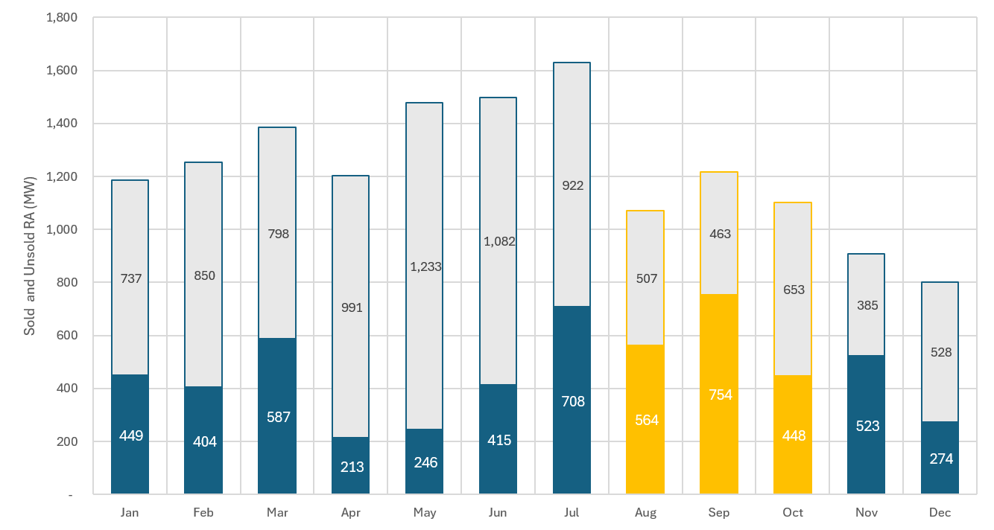
SDG&E 2025 Sold vs. Unsold Resource Adequacy
Item 12
Aug-Oct unsold RA
1,892 MW
Lost revenue opportunity
$30 million*
2025 Indifference Amount
~($30,000)
Unsold RA
Sold RA
Source: 2025 PABA Summary, December 2025 Monthly Volumes Report

Slide 32
Docket No. A.26-05-009: 2027 ERRA Forecast
Item 12
Scheduling Update
Event | Date
Opening Briefs | October 2, 2026
Reply Briefs | October 9, 2026
October Update | October 15, 2026
Resource Adequacy (RA)-Related Issues Still in Dispute:
RA Sales Forecast: the amount of RA SDG&E forecasts it will sell in 2027 impacts PCIA rates.
Retained RA Forecast: the amount of RA SDG&E forecasts it will retain for its own use in 2027 impacts PCIA rates.

Slide 33
QUESTIONS?
Item 12
Alissa Greenwald
agreenwald@keyesfox.com
(913) 302-5567

Slide 34
Questions/Discussion – Item 12

Slide 35
Item 13: Approving Interconnection Package for Encina Biogas-to-Energy Project and Authorizing CEA to Submit Interconnection Applications to SDG&E and CAISO

Slide 36
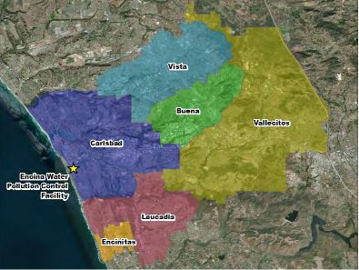
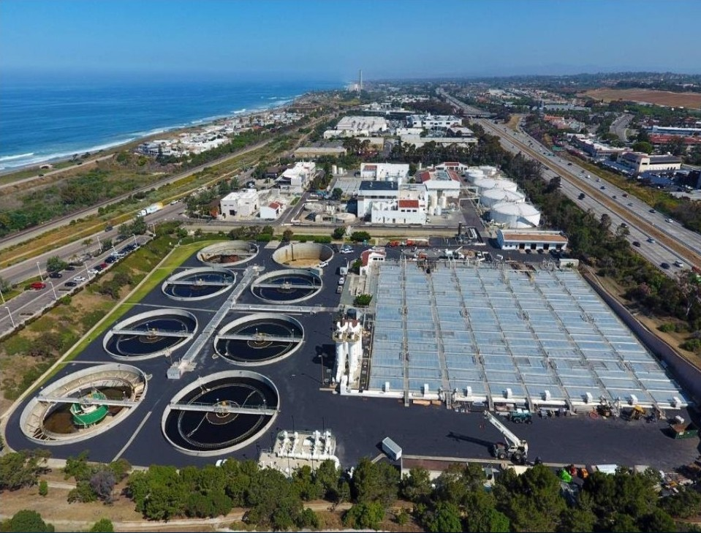
Background
Item 13
Encina Wastewater Authority’s wastewater treatment facilities sit within CEA’s service territory in Carlsbad, and the two public agencies’ Boards share similar services areas and Board representation
Encina and CEA have explored potential collaboration opportunities over the past two years, focusing on potential energy generation or storage facilities that could utilize land or generation resources at the Encina site
MOU approved for initial feasibility efforts in April 2026

Slide 37
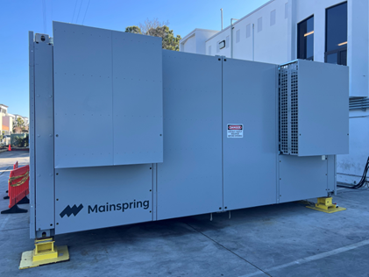
Encina Biogas-to-Energy Project
Item 13
Encina has initiated a current Phase 1 biogas-to-energy project to meet onsite needs and has identified a Phase 2 treatment process which will result in additional production of biogas above what is necessary to support operations at the wastewater treatment facility
The project could offer 4 megawatts (MW) of renewable electricity generation capacity which could supply CEA customers locally – meeting CEA’s needs for Local Resource Adequacy and renewable energy while supporting treatment upgrades desired for the wastewater treatment processes at Encina
Image of future high efficiency / low emissions
linear generator unit

Slide 38
Qualifying for Resource Adequacy
Item 13
Distributed Generation Deliverability
Full Deliverability – CAISO Queue Cluster 16
The DGD study process is intended to allow an alternative streamlined approach to RA for distribution connected resources.
CAISO only studies locations identified by the CPUC with mapped Distributed Solar resources.
No allocations in SDG&E service territory in the past 3 years.
Larger projects typically interconnect by participating in the CAISO-wide Interconnection Cluster Studies managed by CAISO.
Projects are ranked and scored to determine which advance and are allowed to connect.
SDG&E area shows spare capacity, unlike previous queue clusters.

Slide 39
Fiscal Impact & Next Steps
Item 13
Total cost of this package in FY26-27 of $189,000; anticipated 50%/50% split to continue but CEA will be submitting full payments initially.
Future phases of the interconnection process are anticipated to involve additional costs.
The CAISO Queue Cluster 16 process will occur over a series of phases starting this October through 2027 and beyond. CEA will keep the Board apprised of key updates from this process.

Slide 40
Staff Recommendation
Item 13
Adopt Resolution No. 2026-047 approving the Interconnection Package of Agreements related to the Encina Biogas-to-Energy Project, approving an exception to competitive solicitation requirements under Section 4 of Policy CEA-07, awarding the Agreements to GDS Associates, Inc. and Bright Hill Energy, and approving and ratifying the CEO’s respective signatures for these Agreements.
Authorize the CEO to work with the Encina Wastewater Authority to submit the related interconnection applications to SDG&E and CAISO.

Slide 41
Questions/Discussion – Item 13

